Slide 1






Hello Promises
PRESENTED BY:
Darie “Then” Dorlus
Promisor in Chief
darie@bocacode.com

Slide 2

Hello Promises
PRESENTED BY:
Darie “Then” Dorlus
Head Promisor
darie@bocacode.com

Slide 3
Pop Quiz?
What’s a Promise?

Slide 4
Hopefully something you keep!

Slide 5
A Promise
Is an object representing the eventual completion or failure of an asynchronous operation

Slide 6
Asynchronous?

Slide 7
A Synchronous vs Asynchronous fn

Slide 8
A Synchronous vs Asynchronous
function makeBurger() { let beef = getBeef()
let patty = cookBeef(beef) let buns = getBuns()
let burger = putBeefBetweenBuns(buns, patty) return burger
}
let burger = makeBurger() serve(burger)
function makeBurger() { return getBeef()
.then(beef => cookBeef(beef))
.then(patty => getBuns(patty))
.then((buns, patty) =>
putBeefBetweenBuns(buns, patty))
}
makeBurger().then(burger => serve(burger))

Slide 9
Promise me please

Slide 10

new Promise (success, failure)
function getBeef() {
return new Promise((resolve, reject) => { if (beefStack.length) {
resolve(beefStack.pop())
} else {
reject('No beef left! ')
}
})
}

Slide 11
Chaining
Is the art of executing 2+ async operations back to back, where each subsequent operation starts when the previous operation succeeds, with the result from the previous step.

Slide 12
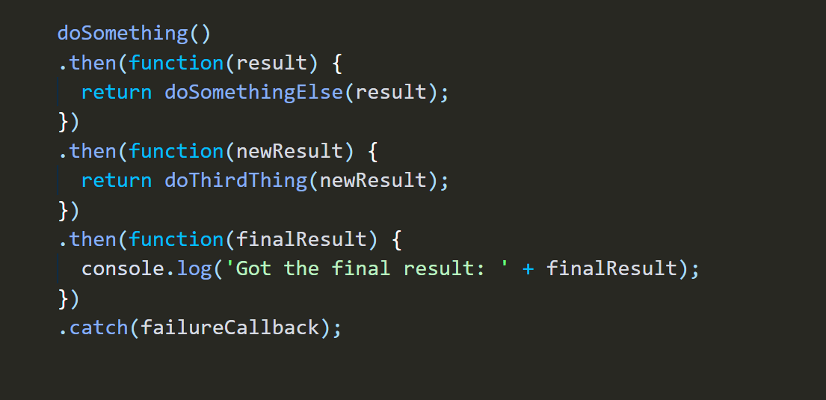
Chaining

Slide 13
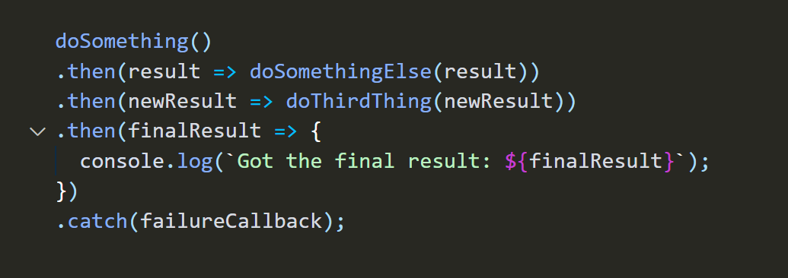
Chaining

Slide 14
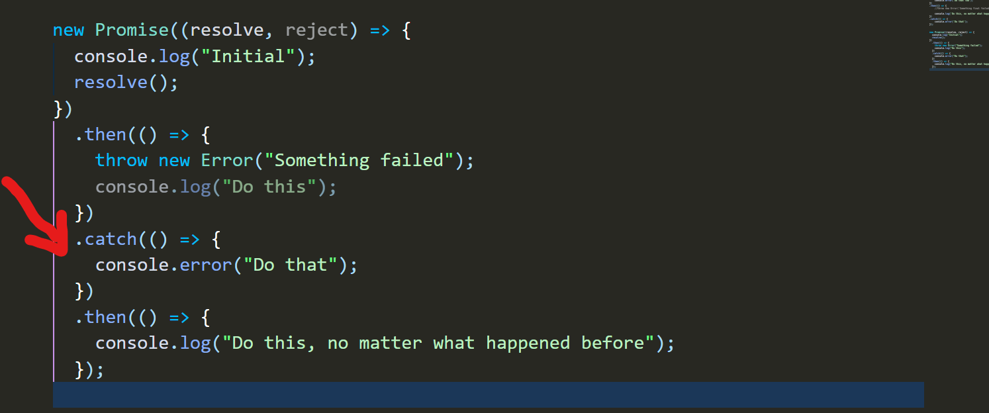
.catch(errorCallBack)
Handling something that went wrong

Slide 15
Async /await

Slide 16
async / await
enable promise-based behavior to be cleaner, avoiding the explicitly need for promise chains.

Slide 17
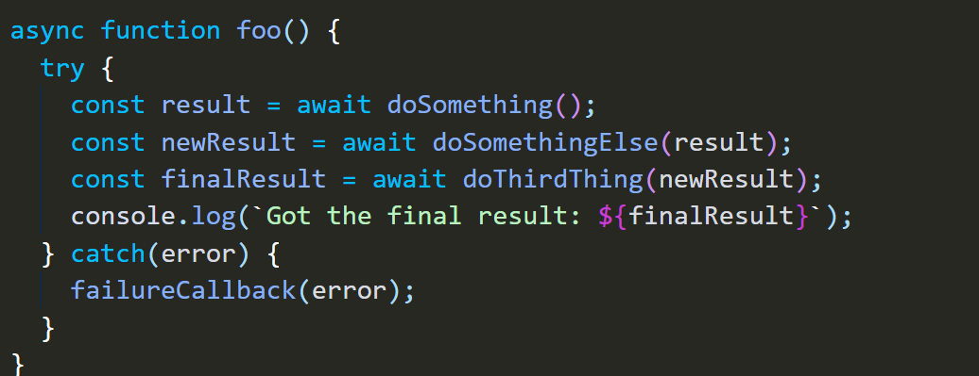
async / await

Slide 18
Thank You.

